Slide 1

Module 15 - Application Case Study – Advanced MRI Reconstruction
Lecture 15.1 – Non-Cartesian MRI Reconstruction

Slide 2
Objective
To learn how to apply parallel programming techniques to an application
Determining parallelism structure
Loop transformations
Memory layout considerations
Validation

Slide 3
Cartesian vs. Non-Cartesian MRI Scan
Cartesian Scan Data
Spiral Scan Data
Gridding
FFT
LS
(a)
(b)
(c)
Notes:
Thus, non-Cartesian trajectories, such as the spiral trajectory shown here, are becoming increasingly popular. These non-Cartesian scans are faster and less susceptible to artifacts than Cartesian scans.
However, the FFT cannot be applied directly to the non-Cartesian scan data. One popular approach is to “grid” the data. That is, the non-Cartesian data (shown in orange) is interpolated onto a uniform grid (shown in blue) using some sort of windowing function. The FFT can then be applied to the interpolated data. This technique introduces inaccuracies and satisfies no statistical optimality criterion, but is very fast, and does produce better images than a Cartesian scan.

Slide 4
Cartesian vs. Non-Cartesian MRI Scan
Cartesian Scan Data
Spiral Scan Data
Gridding
FFT
LS
(a)
(b)
(c)
Notes:
Thus, non-Cartesian trajectories, such as the spiral trajectory shown here, are becoming increasingly popular. These non-Cartesian scans are faster and less susceptible to artifacts than Cartesian scans.
However, the FFT cannot be applied directly to the non-Cartesian scan data. One popular approach is to “grid” the data. That is, the non-Cartesian data (shown in orange) is interpolated onto a uniform grid (shown in blue) using some sort of windowing function. The FFT can then be applied to the interpolated data. This technique introduces inaccuracies and satisfies no statistical optimality criterion, but is very fast, and does produce better images than a Cartesian scan.

Slide 5
Cartesian vs. Non-Cartesian MRI Scan
Cartesian Scan Data
Spiral Scan Data
Gridding
FFT
LS
(a)
(b)
(c)
Notes:
Thus, non-Cartesian trajectories, such as the spiral trajectory shown here, are becoming increasingly popular. These non-Cartesian scans are faster and less susceptible to artifacts than Cartesian scans.
However, the FFT cannot be applied directly to the non-Cartesian scan data. One popular approach is to “grid” the data. That is, the non-Cartesian data (shown in orange) is interpolated onto a uniform grid (shown in blue) using some sort of windowing function. The FFT can then be applied to the interpolated data. This technique introduces inaccuracies and satisfies no statistical optimality criterion, but is very fast, and does produce better images than a Cartesian scan.

Slide 6
Cartesian vs. Non-Cartesian MRI Scan
Cartesian Scan Data
Spiral Scan Data
Gridding
FFT
LS
(a)
(b)
(c)
Notes:
Thus, non-Cartesian trajectories, such as the spiral trajectory shown here, are becoming increasingly popular. These non-Cartesian scans are faster and less susceptible to artifacts than Cartesian scans.
However, the FFT cannot be applied directly to the non-Cartesian scan data. One popular approach is to “grid” the data. That is, the non-Cartesian data (shown in orange) is interpolated onto a uniform grid (shown in blue) using some sort of windowing function. The FFT can then be applied to the interpolated data. This technique introduces inaccuracies and satisfies no statistical optimality criterion, but is very fast, and does produce better images than a Cartesian scan.

Slide 7
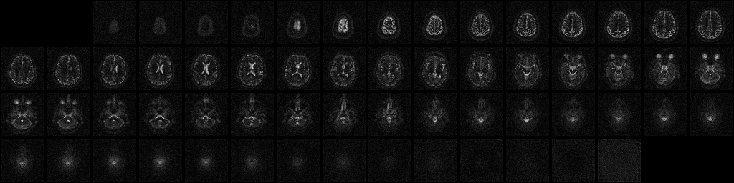
Non-Cartesian Scan
Courtesy of Keith Thulborn and Ian Atkinson, Center for MR Research, University of Illinois at Chicago
Notes:
7

Slide 8
An Iterative Solver Based Approach to Image Reconstruction
Compute F^{H}F + λW^{H}W
Acquire Data
Compute F^{H}D
Find ρ
Notes:
The least-squares reconstruction algorithm poses the reconstruction problem in the form FHF times p = FHd.
1. P is the desired image.
2. FHF is a special data structure that can be derived very quickly from another data structure, Q. Q depends only on the scanner configuration and can therefore be computed before the scan data is even acquired. So, while computing Q is very expensive, this cost can be amortized over many reconstructions, and does not factor into the reconstruction time for any image.
3. FHd is a matrix that depends on both the scanner configuration and the data. Computing FHd is fairly expensive.
Finally, given FHF and FHd, a linear solver is used to find the image. This last step is quite fast. In fact, 99.5% of the reconstruction time for a single image is devoted to computing FHd, and computing Q is even more expensive, so those are the computations that we chose to accelerate on the G80.

Slide 9
Computation of Q and FHD
for (m = 0; m < M; m++) {
phiMag[m] = rPhi[m]*rPhi[m] +
iPhi[m]*iPhi[m];
for (n = 0; n < N; n++) {
expQ = 2*PI*(kx[m]*x[n] +
ky[m]*y[n] +
kz[m]*z[n]);
rQ[n] +=phiMag[m]*cos(expQ);
iQ[n] +=phiMag[m]*sin(expQ);
}
}
(a) Q computation
for (m = 0; m < M; m++) {
rMu[m] = rPhi[m]*rD[m] +
iPhi[m]*iD[m];
iMu[m] = rPhi[m]*iD[m] –
iPhi[m]*rD[m];
for (n = 0; n < N; n++) {
expFhD = 2*PI*(kx[m]*x[n] +
ky[m]*y[n] +
kz[m]*z[n]);
cArg = cos(expFhD);
sArg = sin(expFhD);
rFhD[n] += rMu[m]*cArg –
iMu[m]*sArg;
iFhD[n] += iMu[m]*cArg +
rMu[m]*sArg;
}
} (b) F^{H}D computation

Slide 10
The GPU Teaching Kit is licensed by NVIDIA and the University of Illinois under the Creative Commons Attribution-NonCommercial 4.0 International License.

